Slide 1


AWS Training

Slide 2


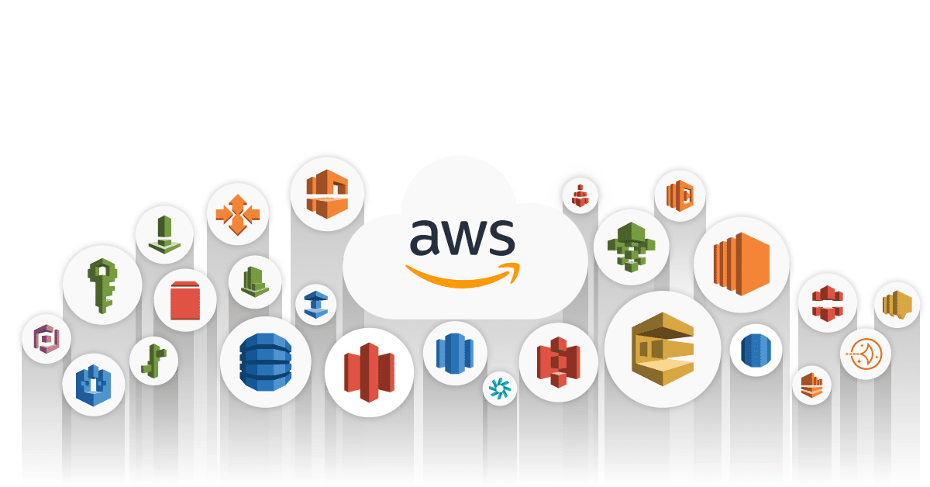

Agenda
Day 1 :
CloudFormation
IAM
Code build
Service Catalog
Hand-on
Day 2 :
ECR
ECS
EKS
CICD in GitHub Actions
CloudFormation vs Terraform
Hand-on

Slide 3
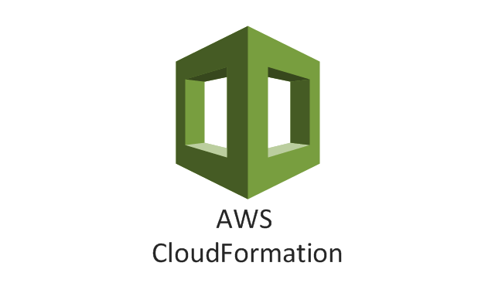
CloudFormation
An easy to way to create and Manage a collection of AWS resource
Allows orderly and predictable provisioning and updating of resources
Allows you to version control your AWS Infrastructure
Deploy and Update stacks using console, command line or API
You only pay for the resources you create.
Transparent and open
Declarative and Flexible
Don’t Reinvent the wheel
No Extra charge
Customized via parameters

Slide 4
CloudFormation - Components & Technology
Template
CloudFormation
Stack
JSON formatted file
Parameter definition Resource creation Configuration actions
Framework
Stack creation Stack updates
Error detection and rollback
Configured AWS services
Comprehensive service support Service event aware Customisable

Slide 5
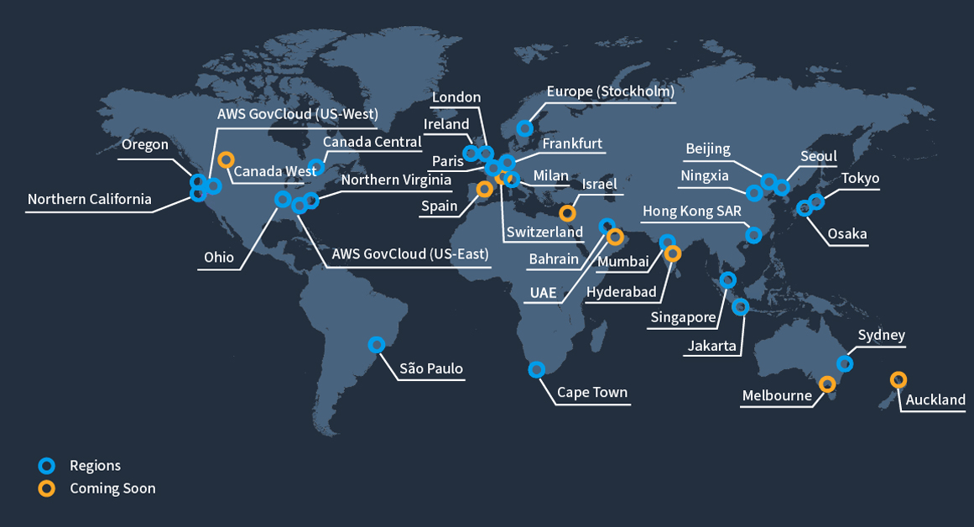
AWS Global Infra – Regions

Slide 6
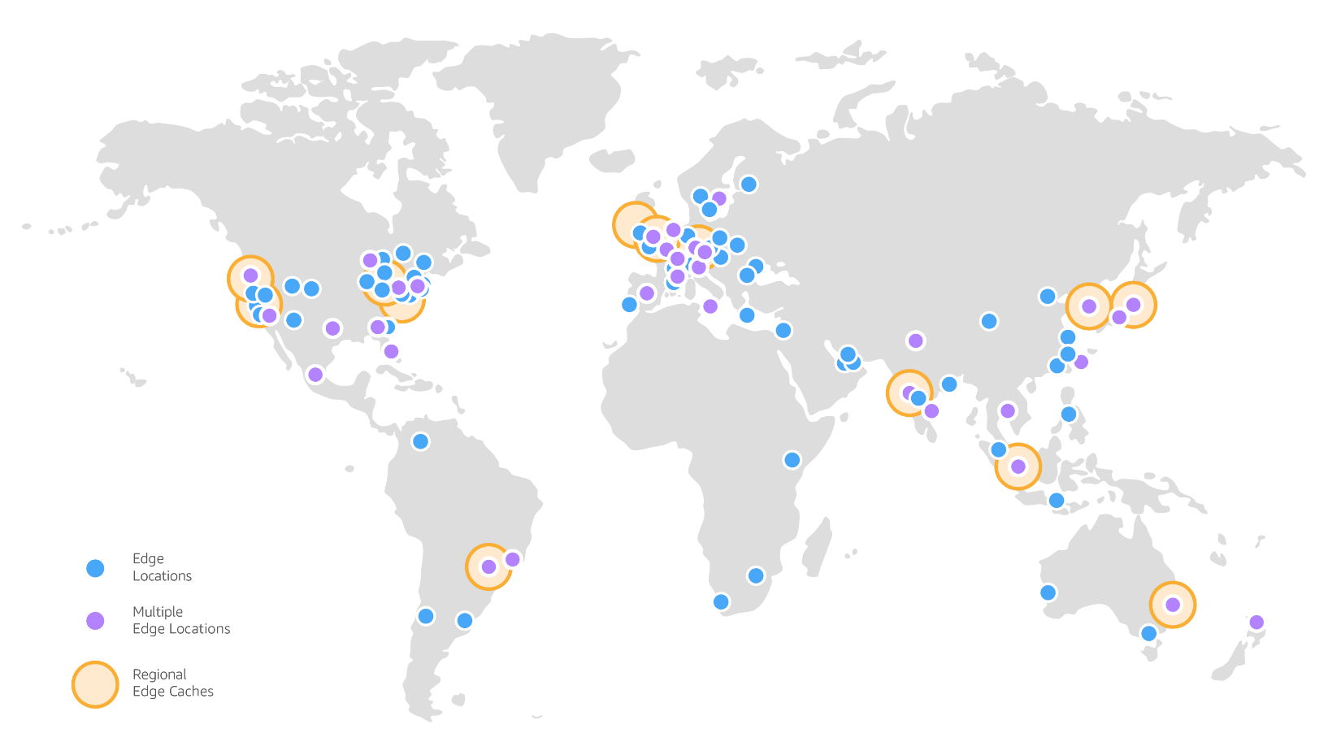
AWS Global Infra – Edge Locations

Slide 7
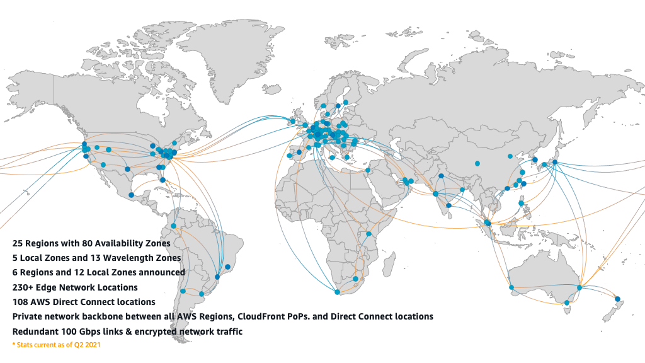
AWS Global Infra – Global Network Connectivity

Slide 8

High Level Template Structure
{
"Description" : "A text description for the template usage", "Parameters": {
// A set of inputs used to customize the template per deployment
},
"Resources" : {
// The set of AWS resources and relationships between them
},
"Outputs" : {
// A set of values to be made visible to the stack creator
},
"AWSTemplateFormatVersion" : "2010-­‐09-­‐09”
}

Slide 9
AWS EC2
Instances
AMI
Instance Types
Instance purchasing options
Instance lifecycle
Instance Security
Storage

Slide 10

A Simple Template that creates an EC2 Instance
{
"Description": "Create an EC2 instance running the latest Amazon Linux AMI.", "Parameters": {
"KeyPair": {
"Description": "The EC2 Key Pair to allow SSH access to the instance", "Type": "String"
}
},
"Resources": { "Ec2Instance": {
"Properties": {
"ImageId": "ami-­‐9d23aeea", "InstanceType" : "m3.medium", "KeyName": {
"Ref": "KeyPair"
}
},
"Type": "AWS::EC2::Instance"
You will be asked to enter values for these parameters when you create your stack
}
},
"Outputs": {
"InstanceId": {
"Description": "The InstanceId of the newly created EC2 instance", "Value": {
"Ref": "Ec2Instance"
}
}
},
"AWSTemplateFormatVersion": "2010-­‐09-­‐09"
}

Slide 11
A Simple Template that creates an EC2 Instance
{
"Description": "Create an EC2 instance running the latest Amazon Linux AMI.", "Parameters": {
"KeyPair": {
"Description": "The EC2 Key Pair to allow SSH access to the instance", "Type": "String"
}
},
"Resources": { "Ec2Instance": {
"Properties": {
"ImageId": "ami-­‐9d23aeea", "InstanceType" : "m3.medium", "KeyName": {
"Ref": "KeyPair"
}
},
"Type": "AWS::EC2::Instance"
}
},
Includes statically defined properties (ImageID & Instance Type) plus a reference to the KeyPair parameter. ImageID is the AMI specific to the region that you will launch this stack in, in this case the eu-west-1 region
"Outputs": {
"InstanceId": {
"Description": "The InstanceId of the newly created EC2 instance", "Value": {
"Ref": "Ec2Instance"
}
}
},
"AWSTemplateFormatVersion": "2010-­‐09-­‐09"
}

Slide 12

A Simple Template that creates an EC2 Instance
{
"Description": "Create an EC2 instance running the latest Amazon Linux AMI.", "Parameters": {
"KeyPair": {
"Description": "The EC2 Key Pair to allow SSH access to the instance", "Type": "String"
}
},
"Resources": { "Ec2Instance": {
"Properties": {
"ImageId": "ami-­‐9d23aeea", "InstanceType" : "m3.medium", "KeyName": {
"Ref": "KeyPair"
}
},
"Type": "AWS::EC2::Instance"
These outputs will be returned once the template has completed execution
}
},
"Outputs": {
"InstanceId": {
"Description": "The InstanceId of the newly created EC2 instance", "Value": {
"Ref": "Ec2Instance"
}
}
},
"AWSTemplateFormatVersion": "2010-­‐09-­‐09"
}

Slide 13
Using a template to create and manage a stack via the AWS CLI
aws cloudformation create-­‐stack
-­‐-­‐stack-­‐name ec2InstanceCmdLineDemo
-­‐-­‐template-­‐url https://s3-­‐eu-­‐west-­‐1.amazonaws.com/cf-­‐ templates-­‐1fhelryvrdrbr-­‐eu-­‐west-­‐1/2014174d0r-­‐ec2Instance.template
-­‐-­‐parameters ParameterKey=KeyPair,ParameterValue=ManagementKeyPair
Returns the details of the created stack, in the output format of your choice
arn:aws:cloudformation:eu-­‐west-­‐1:554625704737:stack/ec2InstanceCmdLineDemo/ 42cc6150-­‐fad7-­‐11e3-­‐8f4d-­‐5017e1aef4e7

Slide 14
Other AWS CLI actions for CloudFormation
cancel-­‐update-­‐stack create-­‐stack delete-­‐stack
describe-­‐stack-­‐events describe-­‐stack-­‐resource describe-­‐stack-­‐resources describe-­‐stacks
get-­‐stack-­‐policy get-­‐template
list-­‐stack-­‐resources list-­‐stacks
set-­‐stack-­‐policy update-­‐stack validate-­‐template
As usual, you can get more details via the AWS CLI
$ aws cloudformation update-­‐stack help

Slide 15
Help via the AWS CLI
$ aws cloudformation update-­‐stack help
SYNOPSIS
update-­‐stack
-­‐-­‐stack-­‐name <value>
[-­‐-­‐template-­‐body <value>] [-­‐-­‐template-­‐url <value>]
[-­‐-­‐use-­‐previous-­‐template | -­‐-­‐no-­‐use-­‐previous-­‐template] [-­‐-­‐stack-­‐policy-­‐during-­‐update-­‐body <value>]
[-­‐-­‐stack-­‐policy-­‐during-­‐update-­‐url <value>] [-­‐-­‐parameters <value>]
[-­‐-­‐capabilities <value>]
[-­‐-­‐stack-­‐policy-­‐body <value>] [-­‐-­‐stack-­‐policy-­‐url <value>] [-­‐-­‐notification-­‐arns <value>]

Slide 16
$ aws cloudformation update-­‐stack help
Built using the
SYNOPSIS
update-­‐stack
-­‐-­‐stack-­‐name <value>
[-­‐-­‐template-­‐body <value>] [-­‐-­‐template-­‐url <value>]
[-­‐-­‐use-­‐previous-­‐template | -­‐-­‐no-­‐use-­‐previous-­‐template] [-­‐-­‐stack-­‐policy-­‐during-­‐update-­‐body <value>]
[-­‐-­‐stack-­‐policy-­‐during-­‐update-­‐url <value>] [-­‐-­‐parameters <value>]
[-­‐-­‐capabilities <value>]
[-­‐-­‐stack-­‐policy-­‐body <value>] [-­‐-­‐stack-­‐policy-­‐url <value>] [-­‐-­‐notification-­‐arns <value>]
CloudFormation API
CloudFormation API Reference : docs.aws.amazon.com/AWSCloudFormation/latest/APIReference/Welcome.html

Slide 17
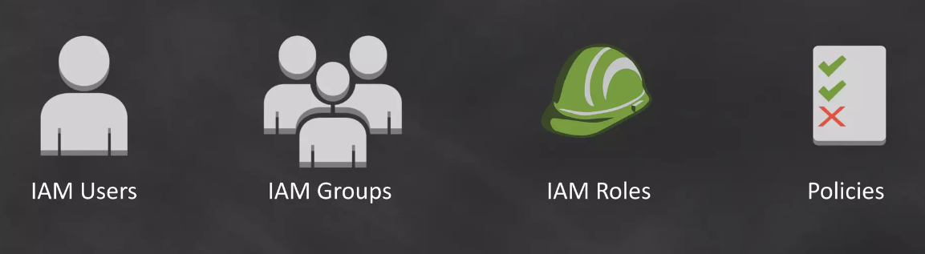
AWS Identity and Access Management (IAM)
Enables you to control who can do what in your AWS Account

Slide 18
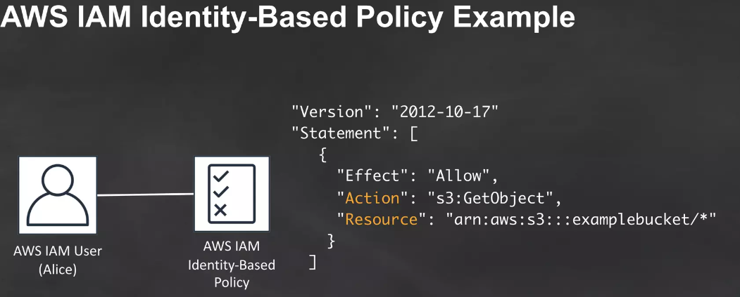
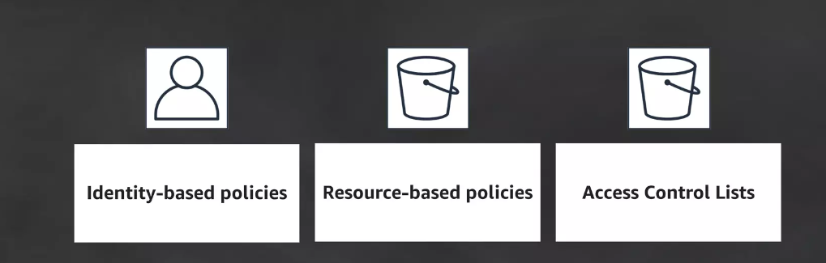
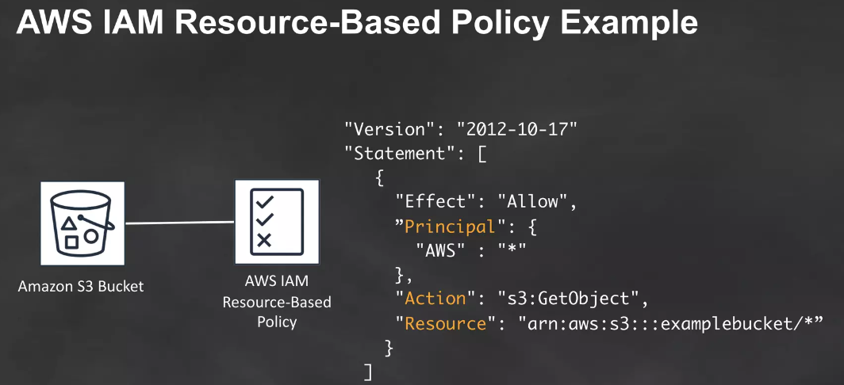
AWS IAM Policy Types

Slide 19
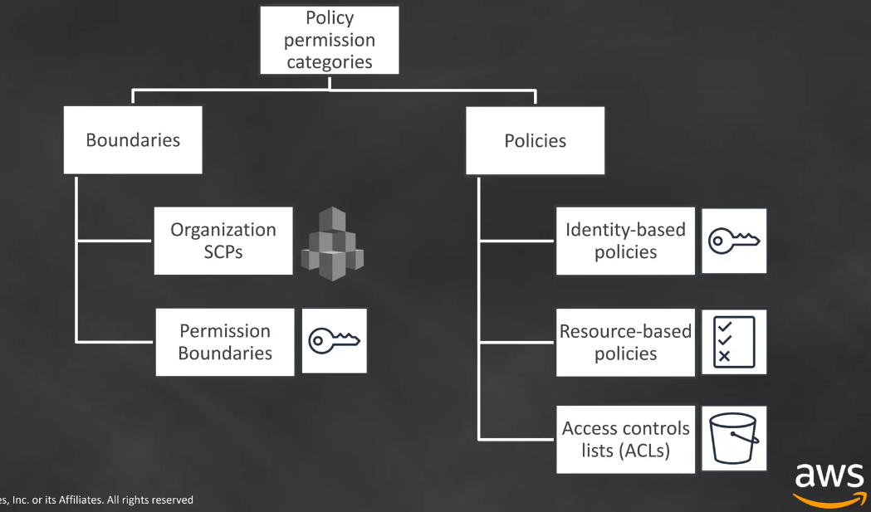
IAM Policy Categories

Slide 20

CodeBuild

Slide 21
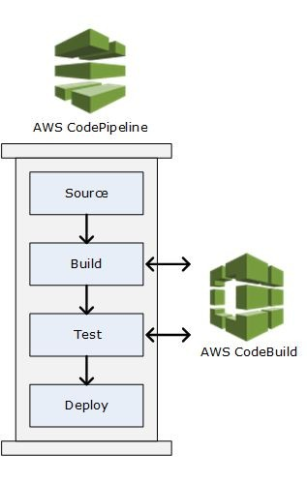

Slide 22
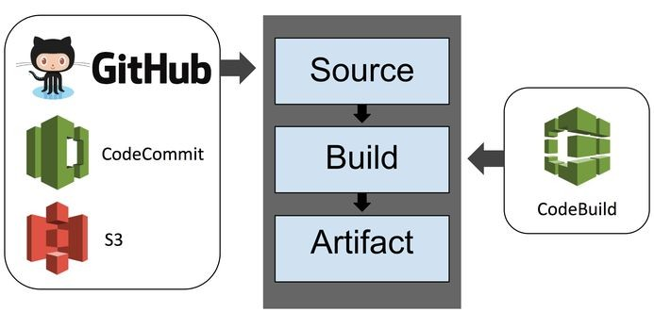
+ BitBucket
+ CodePipeline

Slide 23
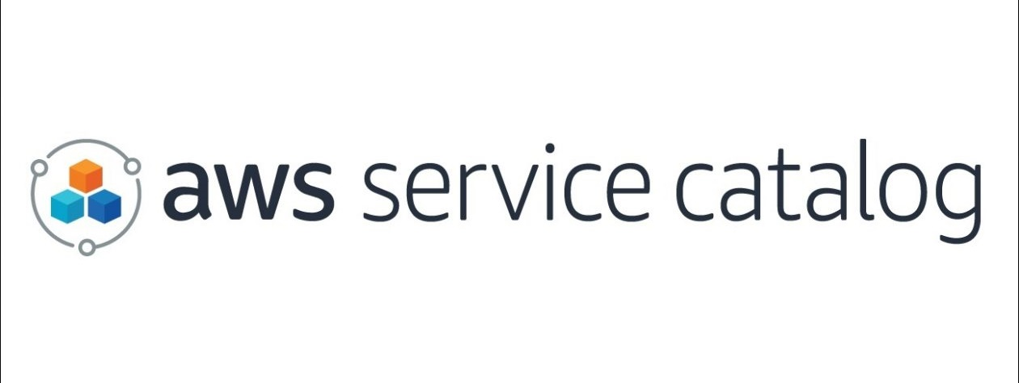
AWS Service Catalog

Slide 24



What is AWS Service Catalog?
AWS Service Catalog allows organizations to create and manage catalogs of IT services. It enables users to quickly deploy the approved IT services they need in a self-service manner.
Control Standardization Governance
Agility Self-service
Time to market
Organizations
Developers

Slide 25
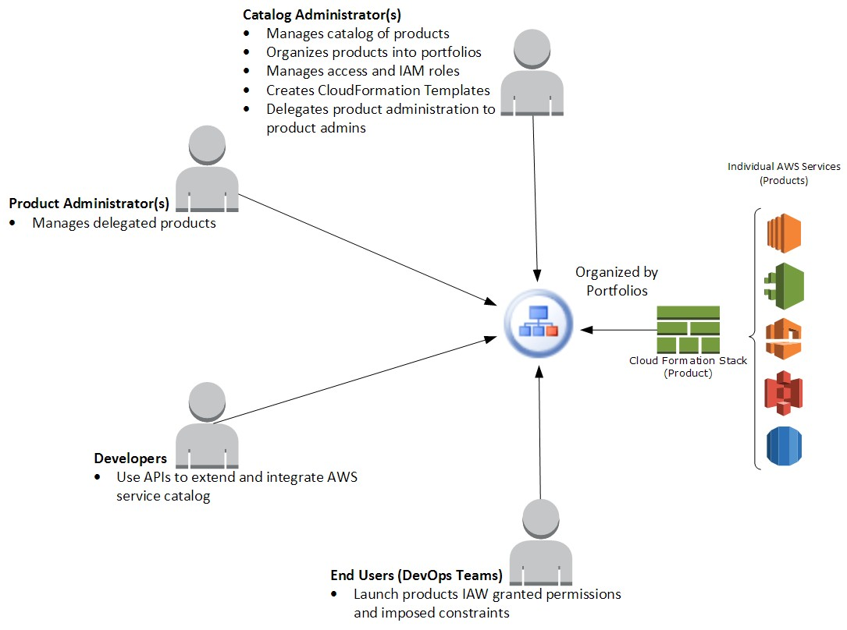
How it works

Slide 26
Pricing and availability
Cost is $5 per portfolio per month
Only portfolios with one or more AWS Identity and Access
Management (IAM) users/groups/roles charged
Fixed fee model, no limit on number of stacks launched
Free introductory period until October 2015
Any active portfolios will be charged starting 10/1/2015
Available today
US East (N. Virginia)
US West (Oregon)
More regions coming soon!

Slide 27


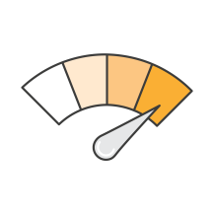
What are the benefits of using AWS Service Catalog?
For organizations—standardization
Promote compliance
Cost management
For administrators—manage IT lifecycle
Controlled access
Centralized management
For devs/app users—increased agility
Simple personalized portal
Self-service provisioning

Slide 28
Day 2

Slide 29








The AWS Container Ecosystem
EC2 Container Service
ECS
CLI
EC2 Container Registry

Slide 30




What is Amazon EC2 Container Registry (ECR)?
Fully Managed
Secure
Highly Available
Simplified Workflow

Slide 31




Docker Images
Docker Images
Packaged application code
Reproducible
Immutable
Portable

Slide 32

Docker Images
Docker Images
Image
hello-ecr:latest
747cb2d60bbe
Layer Data
Layers
a8bdc7fdaa4f
1f7916b037e5

Slide 33

ECR Components
Registry & Repository
Registry Policy
Image
Authorization Token
Amazon ECR

Slide 34
Pricing & Availability
Available in 13 regions
12-month free tier for 500MB image storage
$0.10 per GB / month Docker image storage pricing
Standard AWS Data Transfer Rate

Slide 35
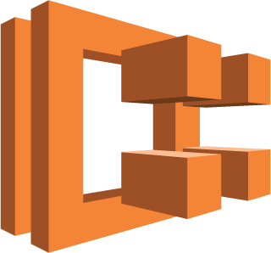
Amazon EC2 Container Service (ECS)
Highly scalable, high performance container management system.
Eliminates the need to install, operate, and scale your own container management infrastructure.

Slide 36
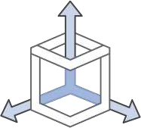


Amazon EC2 Container Service (ECS)
ECS provides a managed platform for:
Cluster management
Container orchestration
Deep AWS integration

Slide 37



How does ECS map to traditional workloads?
Instances: standard EC2 boxes. Once registered to a Cluster, your Tasks run here
Services: layer that manages and places Tasks
Tasks: container wrapper and configuration around processes running on the instance

Slide 38



How does ECS work?
Load balancer: (ALB or EC2 classic) routes
traffic to the cluster instances.
Cluster is made up of one or more EC2 instances
Each cluster instance runs one or more
Services

Slide 39

How does ECS work?
Each cluster instance runs one or more Services
A Service controls things like the number of copies of a Task you want running (Desired Count), and registers your Service with a load balancer
A Task Definition controls things like container image, environment variables, resource allocation, logger, and other parameters

Slide 40

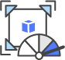



A few features, but many more.
Amazon ECS Task Placement
IAM Roles for Tasks
Flexible scaling for performance
Amazon ECS Event Stream for Cloudwatch Logs
Fast, hassle-free deployments

Slide 41

ELAST IC C ON TAIN ER SER VIC E F OR KU BER N ET ES
(EKS)

Slide 42


Architecture

Slide 43









Master
Master
Master
AWS Managed
Etcd
Etcd
Etcd
Customer Account
Availability Zone 1
Availability Zone 2
Availability Zone 3

Slide 44





Amazon EKS
kubectl
mycluster.eks.amazonaws.com
AZ 1
AZ 2
AZ 3
EKS Workers
Your AWS account

Slide 45







Cross-account Kubernetes
Network Load Balancer
API Access
Static IPs
TLS
ENI Attachment
Workers
Kubectl Exec/Logs
Masters
ENI
Customer VPC
EKS VPC

Slide 46









EKS Cross-Account Networking: Availability Zones
EKS VPC
Master
Master
Master
ENI
ENI
ENI
Customer VPC
Workers
Workers
Workers
Availability Zone 1
Availability Zone 2
Availability Zone 3

Slide 47



Native VPC networking with CNI plugin
Pods have the same VPC address inside the pod
as on the VPC
Open source and on Github
Simple, secure networking
https://github.com/aws/amazon-vpc-cni-k8s

Slide 48

Agenda
Introduction
Components of GitHub Actions
Workflows
Events
Jobs
Steps
Actions
Runners
Why care about Github Actions?

Slide 49
Introduction
GitHub Actions help you automate tasks within your software development life cycle.
GitHub Actions are event-driven, meaning that you can run a series of commands after a specified event has occurred.
For example, every time someone creates a pull request for a repository, you can automatically run a command that executes a software testing script.

Slide 50
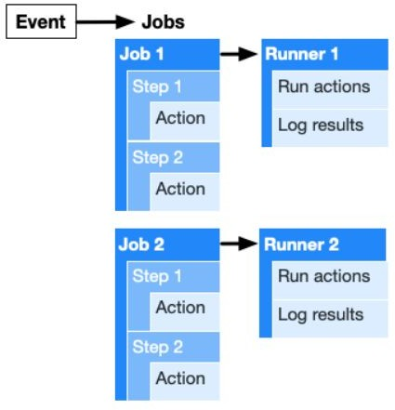
The components of GitHub Actions
Workflows
Events
Jobs
Steps
Actions
Runners

Slide 51
What are Workflows?
The workflow is an automated procedure that you add to your repository.
They are made up of one or more jobs and can be scheduled or triggered by an event.
It can be used to build, test, package, release, or deploy a project on GitHub.
Workflows can be created inside the .github/workflows directory by adding a .yml workflow file.
For example, add .github/workflows/continuous-deployment.yml to your project.

Slide 52
What are Events?
An event is a specific activity that triggers a workflow. For example, activity can originate from GitHub when someone pushes a commit to a repository or when an issue or pull request is created.
You can also use the repository dispatch webhook to trigger a workflow when an external event occurs.

Slide 53
What are Jobs?
A job is a set of steps that execute on the same runner.
By default, a workflow with multiple jobs will run those jobs in parallel. You can also configure a workflow to run jobs sequentially.
For example, a workflow can have two sequential jobs that build and test code, where the test job is dependent on the status of the build job. If the build job fails, the test job will not run.

Slide 54
What are Steps?
A step is an individual task that can run commands in a job.
A step can be either an action or a shell command.
Each step in a job executes on the same runner, allowing the actions in that job to share data with each other.

Slide 55
What are Actions?
Actions are standalone commands that are combined into steps to create a job.
Actions are the smallest portable building block of a workflow.
You can create your own actions, or use actions created by the GitHub community. To use an action in a workflow, you must include it as a step.

Slide 56
What are Runners?
A runner is a server that has the GitHub Actions runner application installed.
You can use a runner hosted by GitHub, or you can host your own.
A runner listens for available jobs, runs one job at a time, and reports the progress, logs, and results back to GitHub.

Slide 57
Types of Runners
GitHub-hosted runners are based on Ubuntu Linux, Microsoft Windows, and macOS, and each job in a workflow runs in a fresh virtual environment. (GitHub-hosted runner)
If you need a different operating system or require a specific hardware configuration, you can host your own runners. (Self-hosted runner)

Slide 58
Supported runners and hardware resources
Hardware specification for Windows and Linux virtual machines:
2-core CPU
7 GB of RAM memory
14 GB of SSD disk space
Hardware specification for macOS virtual machines:
3-core CPU
14 GB of RAM memory
14 GB of SSD disk space

Slide 59
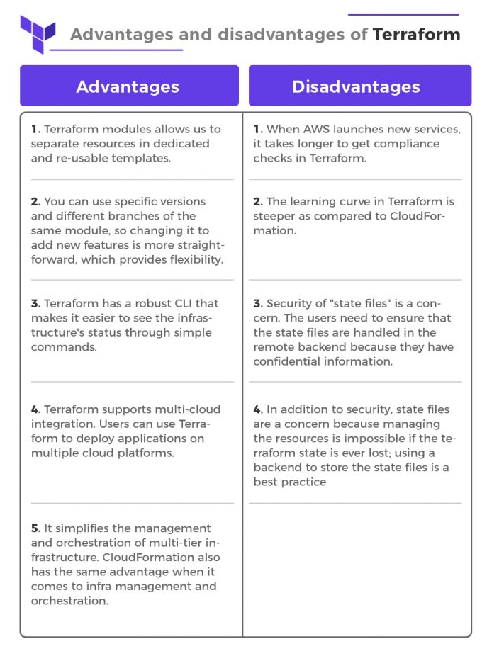

Slide 60
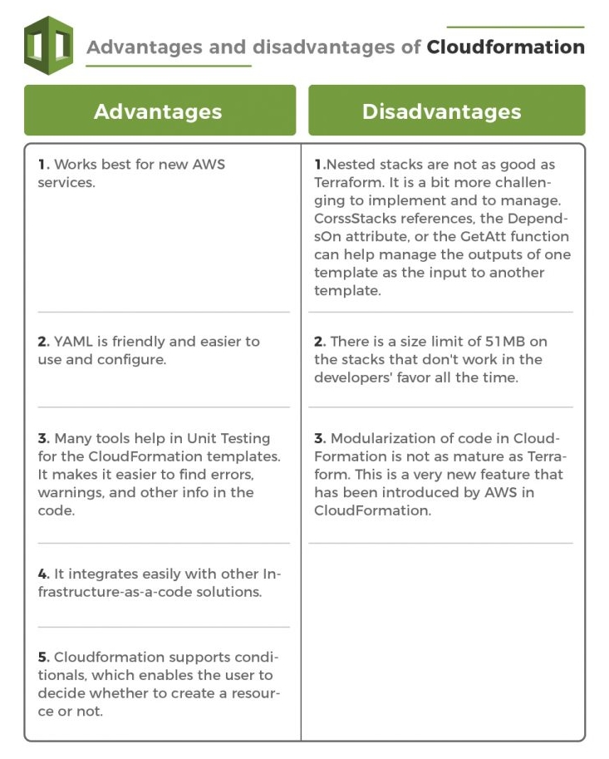

Slide 61


Thank You

